Slide 1
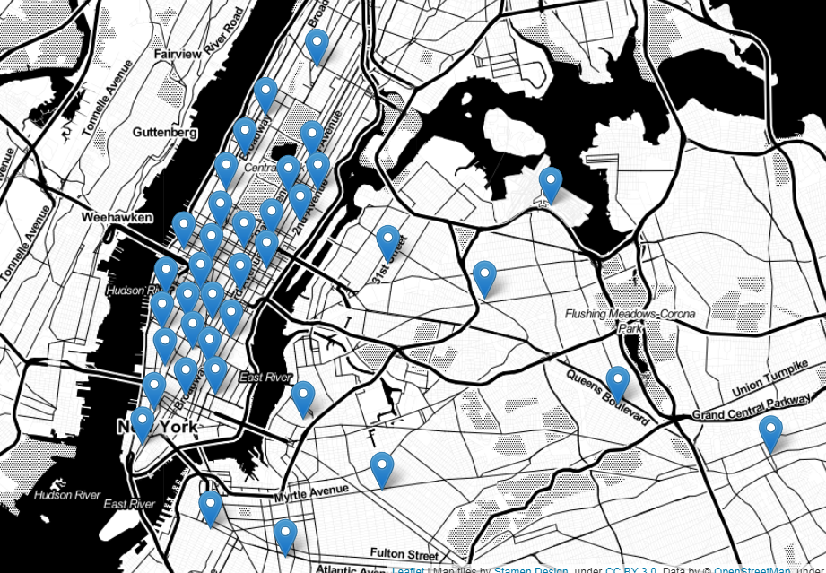
Taxi Demand Prediction
By Eddie Amaitum

Slide 2


Demand in taxi/car share industry
Drivers (Supply) Vs Customers(Demand)
Companies need to forecast demand

Slide 3

Solution: Predict taxi demand per hour by location
Operations team can adjust the distribution of drivers
Operations team
$ 3 for pick-ups around the arena

Slide 4
Impact
Predictive models shown to cut wait times by up to 20%
Improved efficiency in driver deployment hence companies generate more revenue
Increased customer satisfaction

Slide 5
Dataset
NYC Taxi & Limousine Commission (TLC) Trip Records
The data is relatively clean
Feature engineering needed

Slide 6
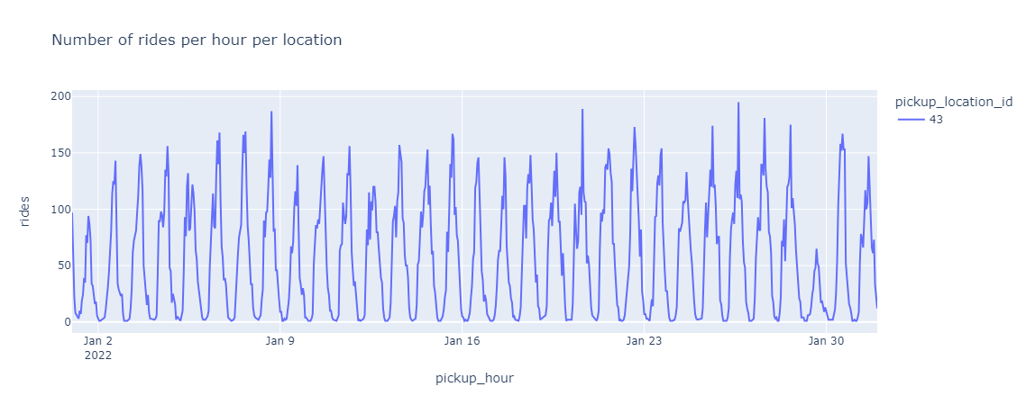
Sample Time Series Data

Slide 7
Data transformation into (features, targets)
Raw data
Validated data
Time Series data
Features, targets for modelling
Filter
Aggregate
Slice

Slide 8
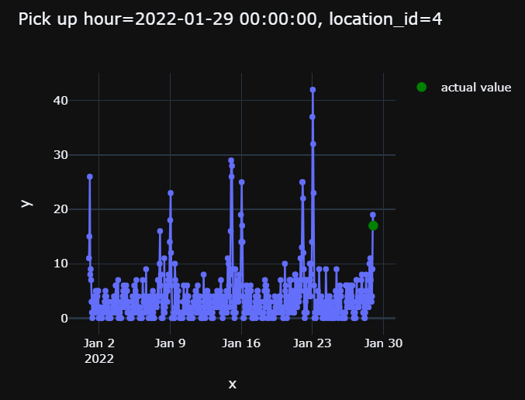
Sample Features & Target Variables
Target

Slide 9
Split the data
Train data
Tabular data with features and target
Data preparation
Split by date e.g Aug
Test data

Slide 10
Baseline models
Baseline model 1
NoML
Baseline model 2
NoML
Baseline model 3
NoML
Train data
Tabular data with features and target
Test data
MAE 1 = 6.05
MAE 2 = 3.68
MAE 3 = 3.19

Slide 11
Model comparison
Model | Mean Absolute Error (MAE) | Notes
Ad Hoc model 1 | 6.05 | Baseline model
Ad Hoc model 2 | 3.68 | Baseline model
Ad Hoc model 3 | 3.19 | Baseline model
XGBoost | 2.70 | Models improved
Lightgbm | 2.57 | Models improved
Lightgbm + feature engineering | 2.59 | Added average rides per month
Lightgbm + hyperparameter tuning | 2.54(num_leaves,min_child_samples,etc) | Best model for production

Slide 12

Further improve model performance by adding more features
Build pipelines to automate processes
Complete model operationalization

Slide 13
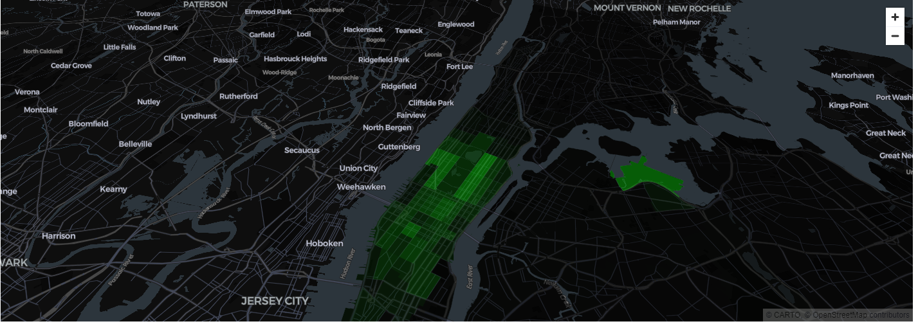
Application dashboard

Slide 14





Eddie Amaitum
Data Scientist

